Slide 1
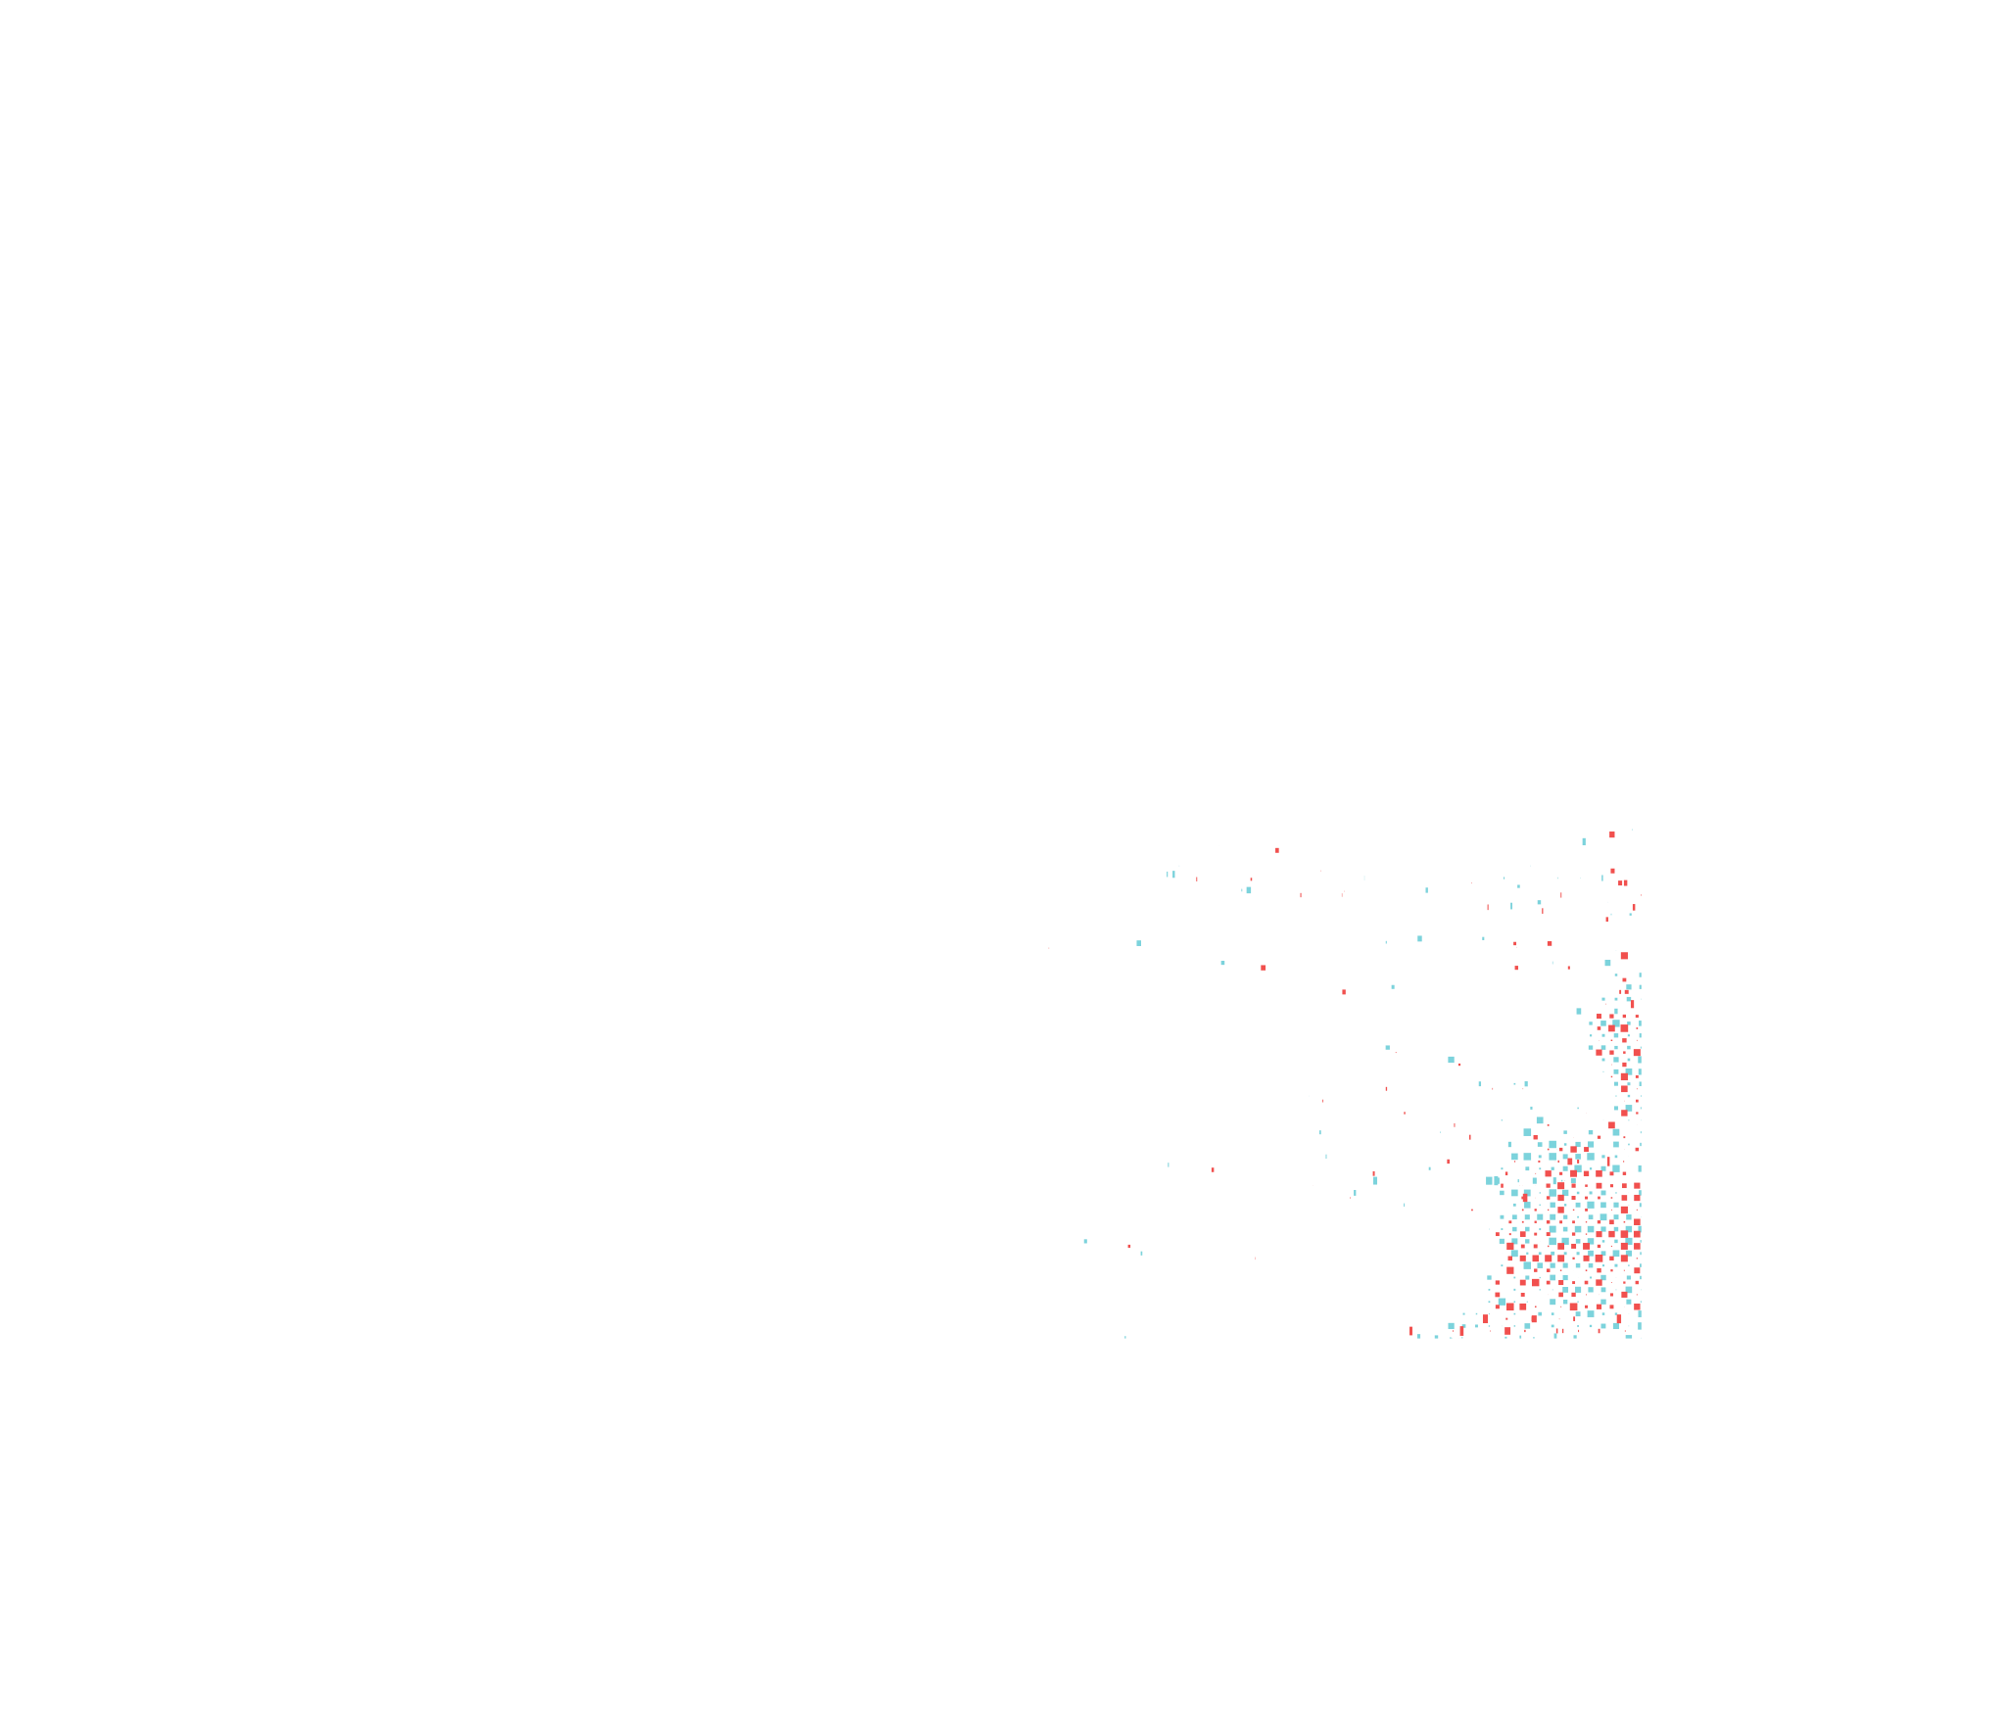


Document Layout Analysis
Tran Tuan Anh - Tommy
Consultant AI Researcher

Slide 2


Content
Challenge statement
Evaluation metric
Submission requirement
Appendix - Guideline and visualization of template
Reference

Slide 3
Challenge statement
Designing a system/algorithm to analyze the layout of Vietnamese document image (respect to magazine).
Input:
Vietnamese document image
Output:
Layout structure (XML form - following the template of sample data)

Slide 4
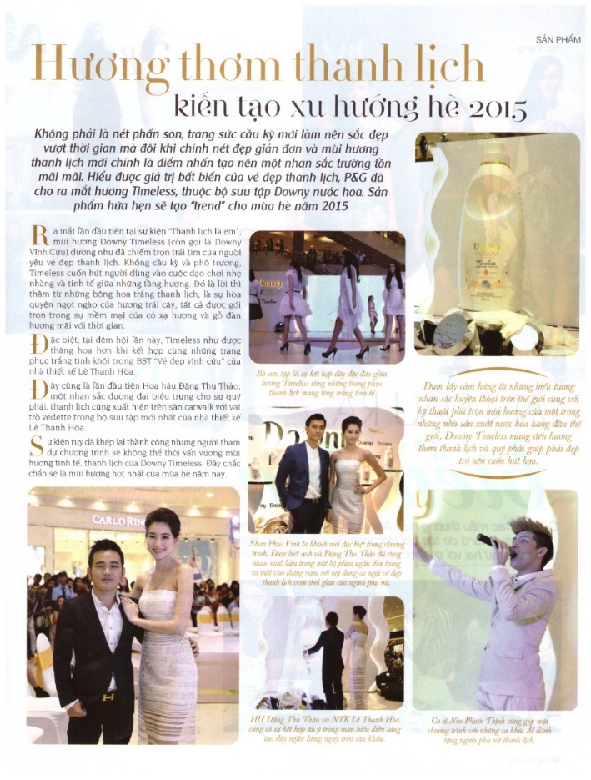
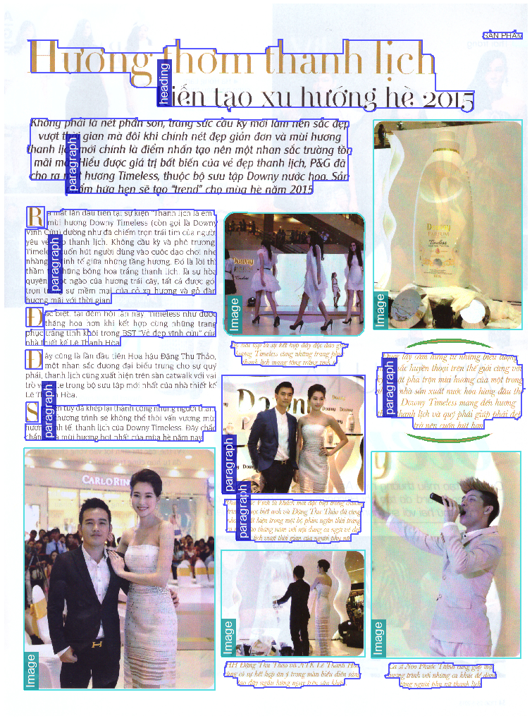
Challenge statement
Input
Expected Result

Slide 5
Evaluation metric
Evaluation Algorithm
Scenario driven in-depth performance evaluation of document layout analysis methods [5].
Evaluation criteria
Text regions / Classification/ Segmentation/ Segmentation, and Classification
General segmentation [1, 4]
Evaluation tool
LayoutEvalGUI 1.8
Link: https://www.primaresearch.org/tools/PerformanceEvaluation

Slide 6
Submission requirement
First round
Executable files
Result on sample dataset
Second round
Code and executable files
Proposal
Third round:
AI camp

Slide 7
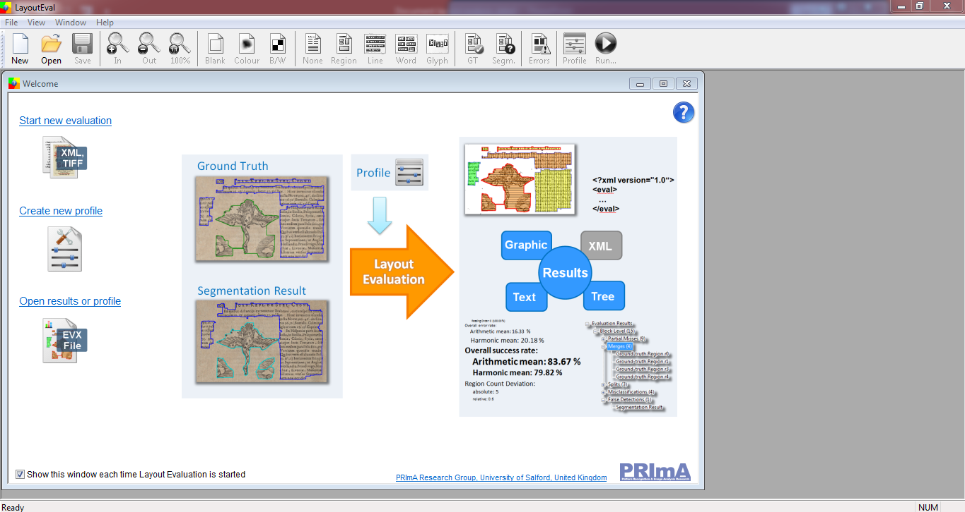
Appendix - Guideline and visualization of template
LayoutEvalGUI 1.8 from PrimA lab (in the folder layout evaluation tool)
Start new evaluation

Slide 8
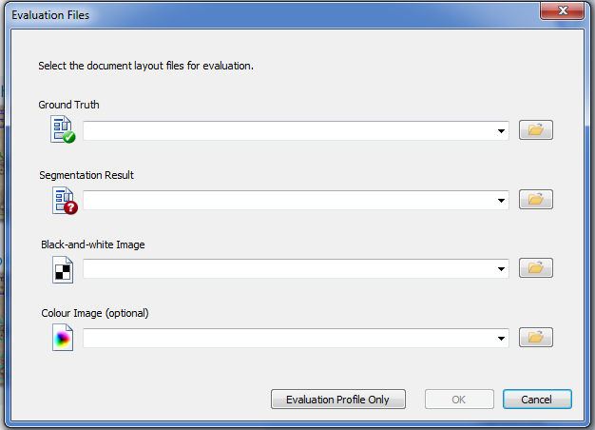
Appendix - Guideline and visualization of template
Load ground-truth XML file
Load your result XML file
Load a binary image of the input image (*)
(*) Participant can create the binary image by yourself.

Slide 9
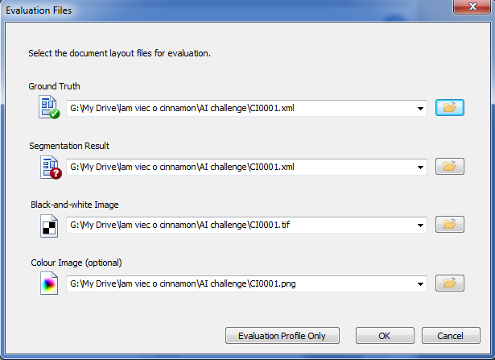
Appendix - Guideline and visualization of template
Load ground-truth XML file
Load your result XML file (or ground-truth file again)
Load a binary image of the input image
Click ok when everything is ok

Slide 10
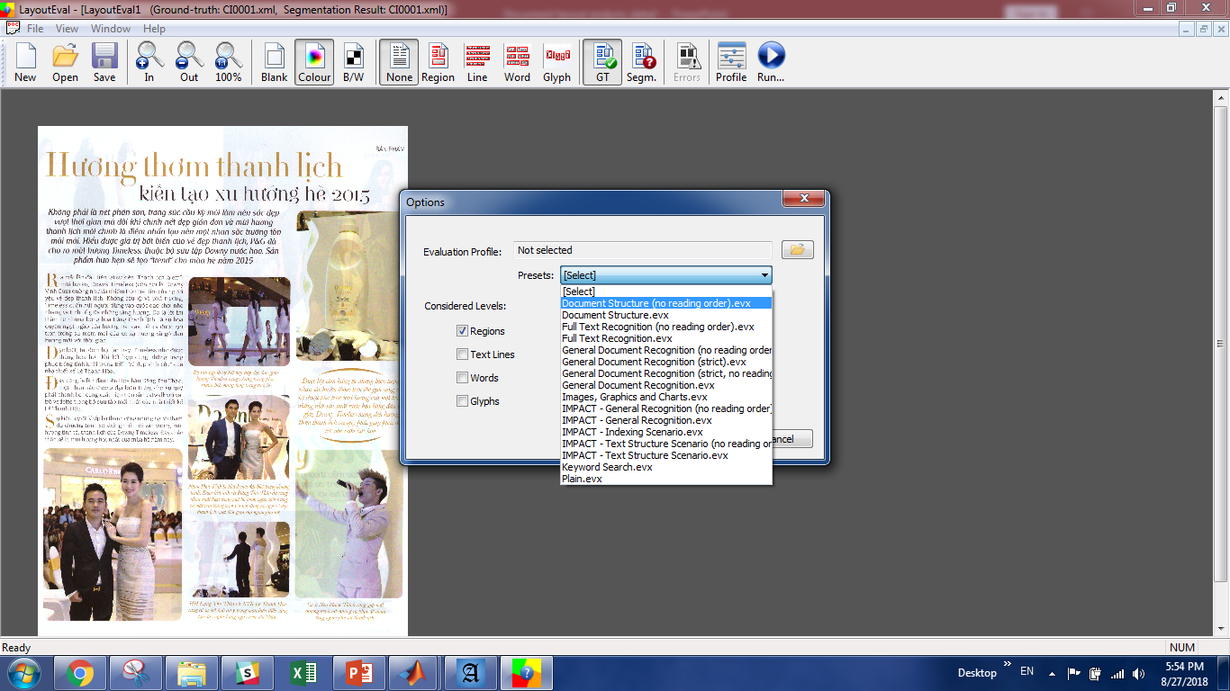
Appendix - Guideline and visualization of template
Click run
Choose a random evaluation profile
Then click ok

Slide 11
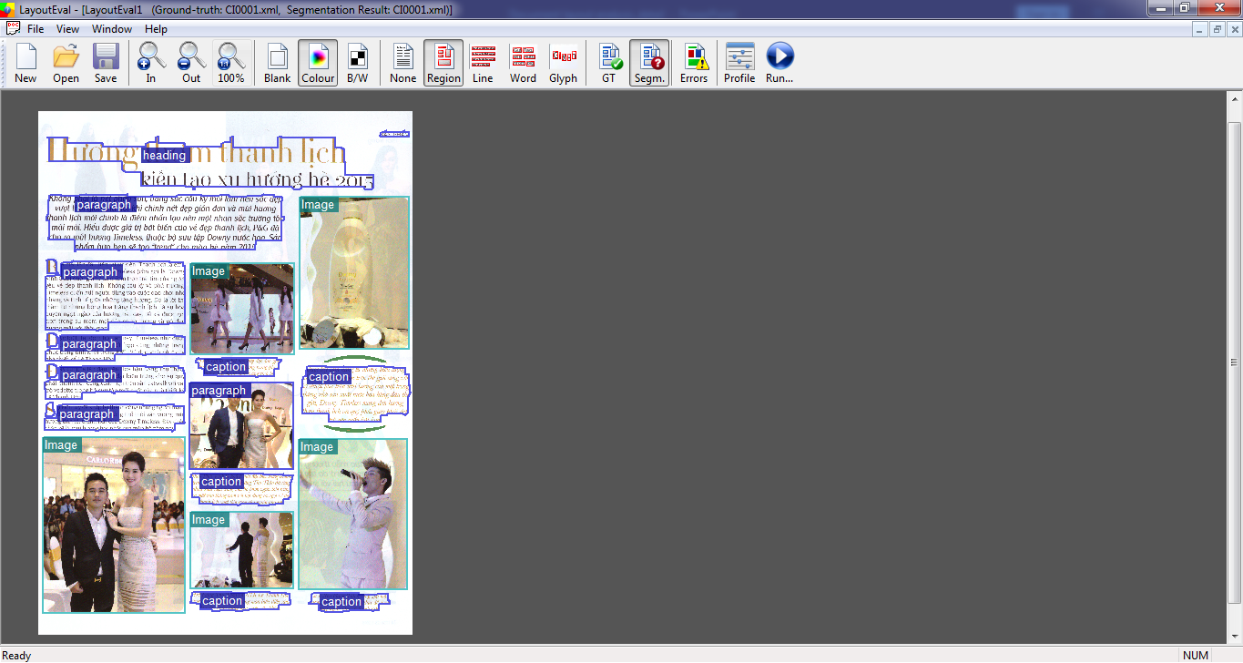
Appendix - Guideline and visualization of template
Show error area
Your segmentation result
Ground-truth

Slide 12
References
[1] Tran, T.A., Kanghan Oh, In-Seop Na, Guee-Sang Lee, Hyung-Jeong Yang, Soo-Hyung Kim, A robust system for document layout analysis using multilevel homogeneity structure, vol 85, pp. 99-113, 2017.
[2]Antonacopoulos, A., Clausner, C., Papadopoulos, C., & Pletschacher, S. (2015). ICDAR2015 competition on recognition of documents with complex layouts - RDCL2015. In Proceedings of the 13th ICDAR (pp. 1151–1155).
[3]Sébastien Eskenazi, Petra Gomez-Krämer, Jean-Marc Ogier, A comprehensive survey of mostly textual document segmentation algorithms since 2008, Pattern Recognition 64 (2017) 1–14
[4] C. Clausner, A. Antonacopoulos, and S. Pletschacher, ICDAR2017 Competition on Recognition of Documents with Complex Layouts –RDCL2017 , ICDAR2017, Kyoto, Japan, 2017.
[5] Clausner, C., Pletschacher, S., & Antonacopoulos, A. (2011). Scenario driven in-depth
performance evaluation of document layout analysis methods. In Proceedings of
the 11th ICDAR (pp. 1404–1408).

Slide 13






About Cinnamon AI Marathon
Time: 25th August to 28th October, 2018
Kick-off event: Circo Coworking Space, 1st - 2nd Floor, 384 Hoang Dieu Street, District 4, HCMC
Workshop: Hanoi
AI Bootcamp: VC3/40 Villa Vinhome Golden River, 2 Ton Duc Thang, Ben Nghe Ward, District 1, HCMC
Target candidates: Entry/Junior AI talents (Open for oversea talents) - Math - Critical thinking/Problem solving skills - GRIT: passion & perseverance

Slide 14

Cinnamon AI Marathon Award

Slide 15
Timeline
25th August - 15th September
Team/Individual registration
Receiving challenge and data sample
16th September - 5th October
Release training data/ more sample data, proposal guidelines, upload submission (output /EXE file) on Leaderboard
Phase 1
Challenge Exposure & Solution Submission
5th Oct - 14th October
Round 1: Top 20 for each challenge submit code for private test.
Round 2: Proposal submission & Interview (in Hanoi & HCMC).
Phase 2
Proposal Evaluation
Phase 3
AI Bootcamp
26th-27th-28th October
Intensive coding & coaching in HCM office for top 6
Conclusion and award ceremony.

Slide 16


Thank you!

